Slide 1
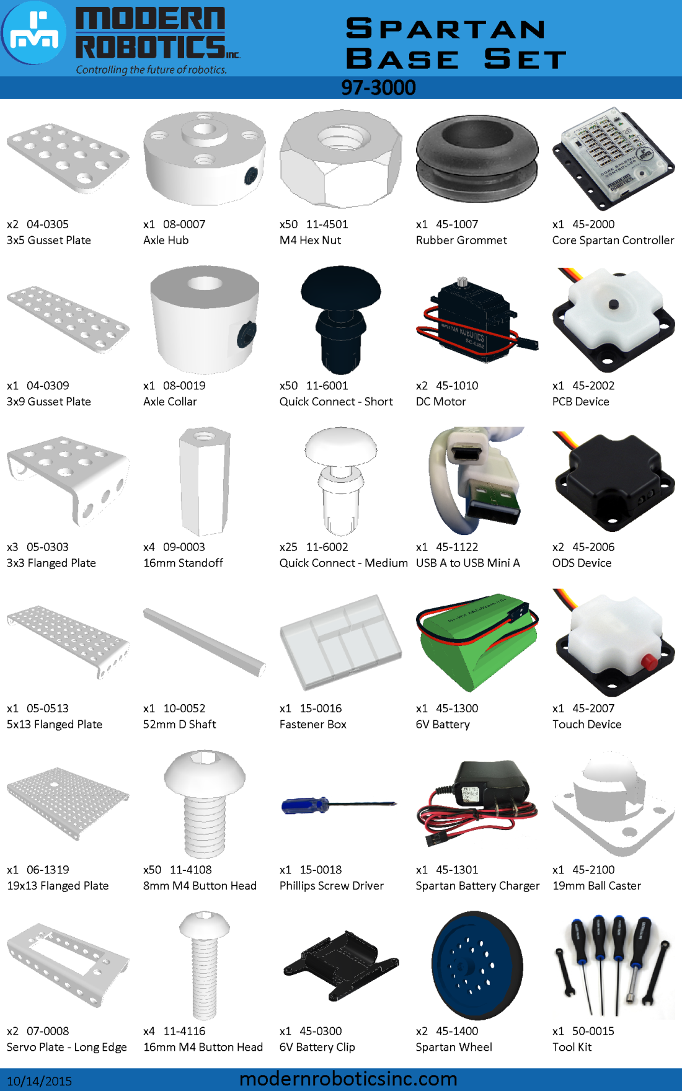

Slide 2
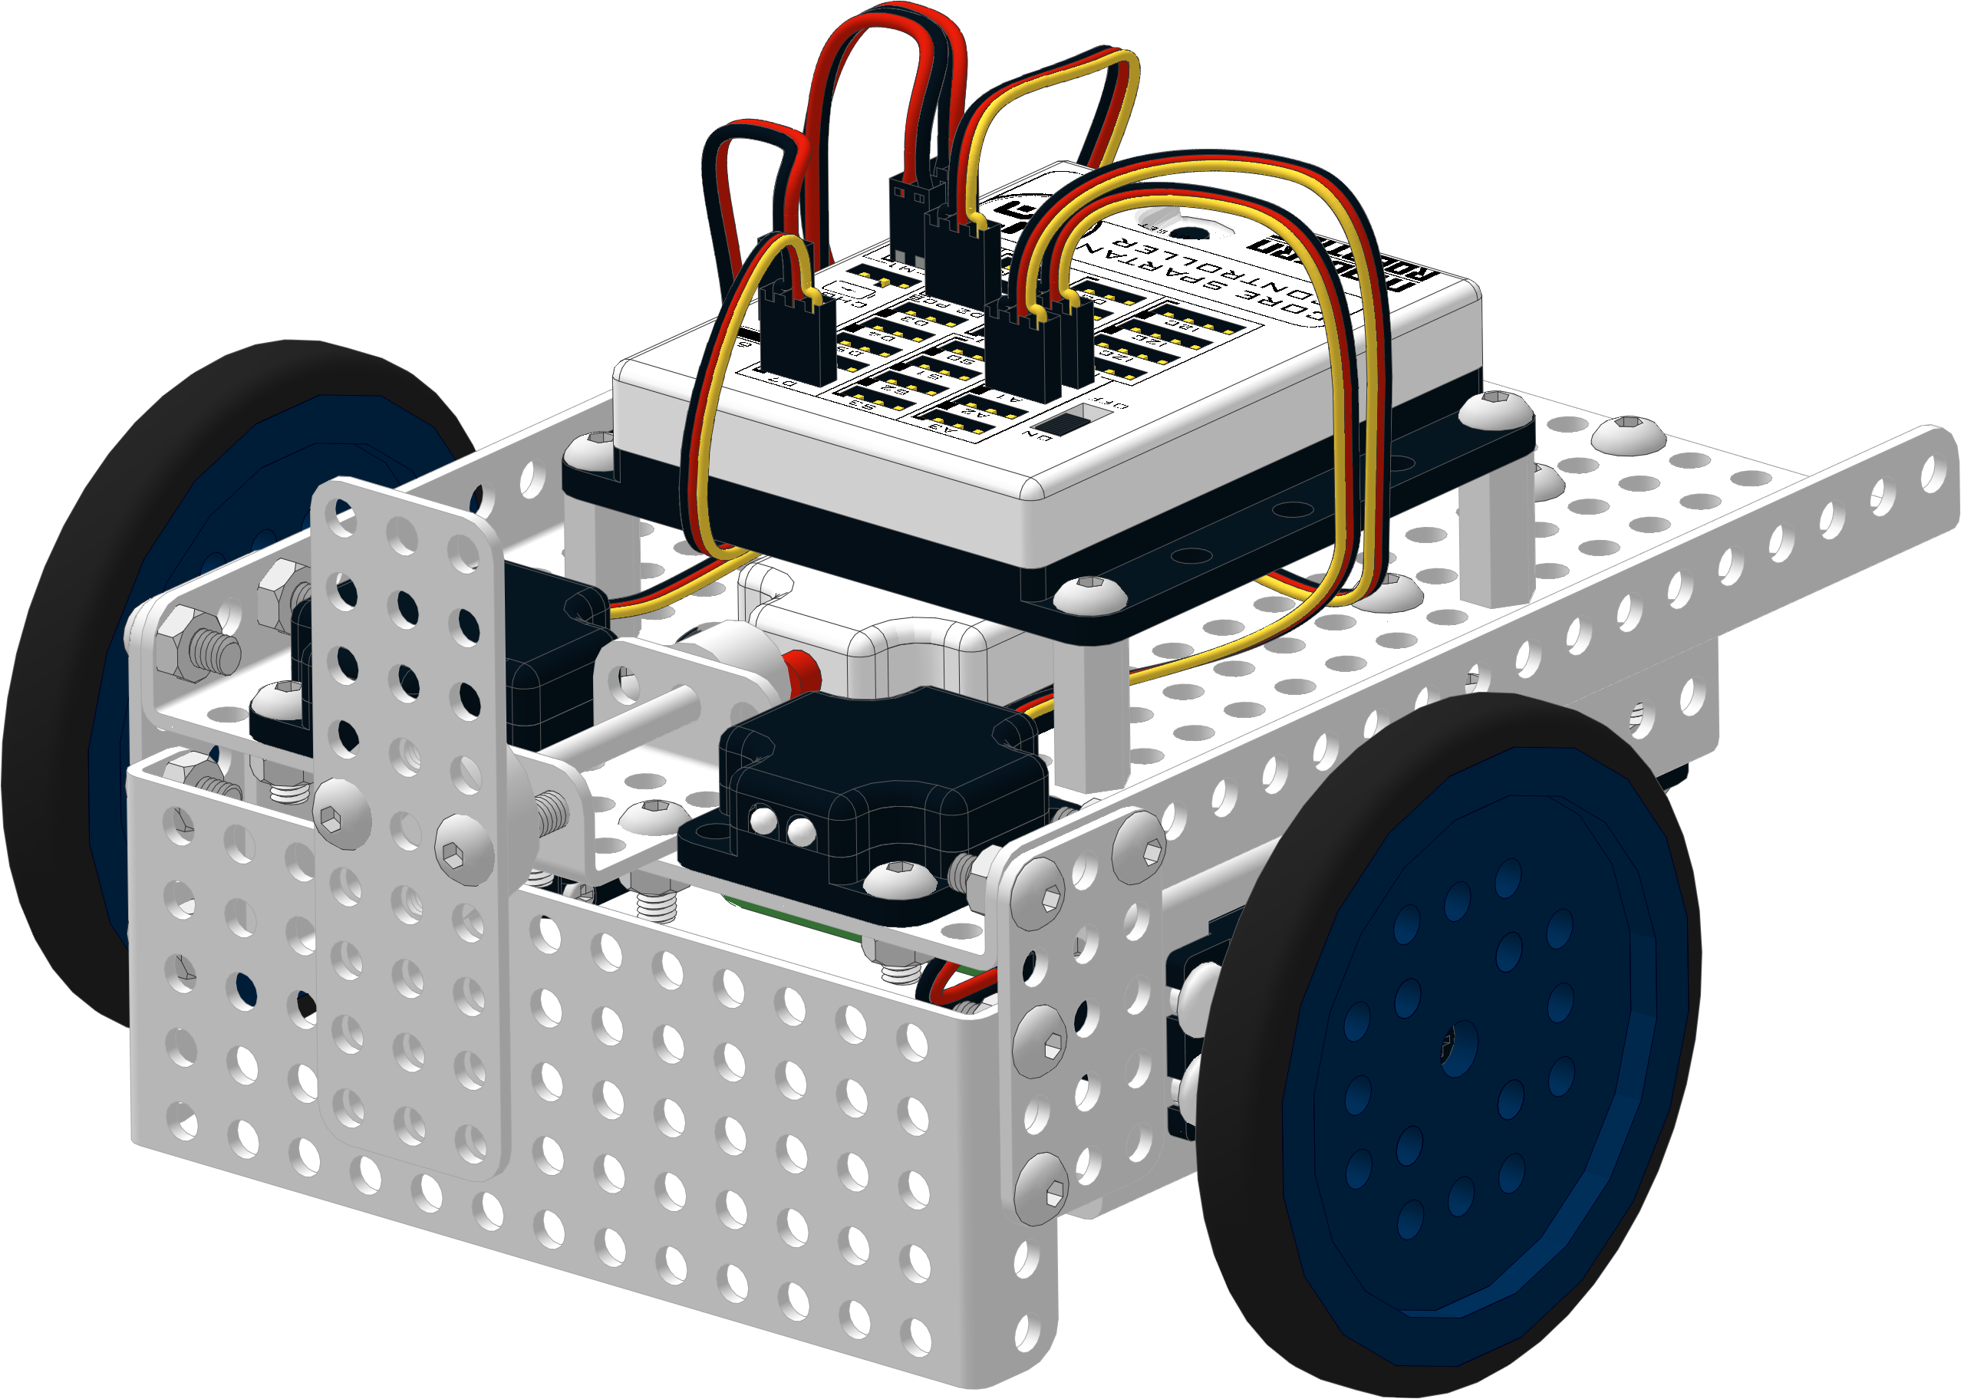


Spartan Robot Kit
The Modern Robotics Spartan kit includes everything you need to build your Arduino compatible Spartan Robot. The Spartan uses the Matrix Robotics building system
allowing you to easily expand your
robot with additional parts and add-on
kits. The Matrix building system allows you to build in 3D and stay on an 8mm grid. Visit Modern Robotics for a detailed description of all compatible sensors and products related to the Spartan System.
Getting Started
There are two main steps to getting your Spartan Robot running, assembling the Spartan base robot and installing the software.
The Getting Started Guide, Building instructions, Programming Guide and software download links are available at www.modernroboticsinc.com/spartan.
There you will also find further documentation and links to other valuable information on Modern Robotics products.
Product Registration and Warranty
Congratulations on your Modern Robotics Spartan purchase.
Please take a moment to register your products with us for warranty/support and to receive updates on the latest Modern Robotics sensors and products.
To register, go to
www.modernroboticsinc.com/warranty-registration
Made In USA
©Modern Robotics, Inc 2015

